Slide 1
INTERVIEWS Your Marketing Tool Kit

Slide 2
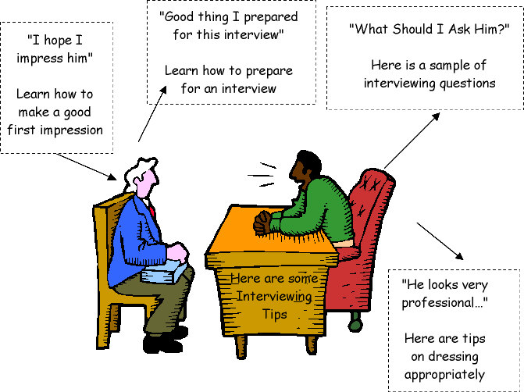

Slide 3
Purpose of an Interview
An interview is an opportunity to learn whether or not there is a “fit” between you and the employer.
Your chance to “advertise” yourself to your future peers.

Slide 4
Importance of Campus Recruitment
An opportunity to be presented to some of the best Companies within your interest.
A job offer while still in college and joining just after graduating - all students dream of!

Slide 5
Benefits Of Campus Recruitment
Quicker placements after graduation
Better remuneration packages
Large choice of job opportunities
Build career in area of prominent skills, interests.

Slide 6
What is being tested?
Three Cs:
Capability
Credibility
Confidence

Slide 7
Frequently Asked Questions
(General)

Slide 8
1. Tell Me about Yourself.
Objective: Make interviewee comfortable and clarity of thought.
Effective Answering Technique:
Must sell what the buyer is buying
Try to uncover your interviewer's greatest need, want, problem or goal
Mention biggest strength and the major benefit that a company will derive from this strength
Sample Answer:
I am XYZ. I have done my schooling from ABC School. I developed an interest in science and technology. And I got into engineering and developed PQR (technical)skills which will help me in this job...

Slide 9
2. What is your greatest weakness?
Objective: Knowing self and how you overcome.
Effective Answering Technique:
Mention a negative that will not affect the job
Assure the interviewer that you can think of nothing that would stand in the way of your performing in this position with excellence. Then, quickly review you strongest qualifications
Sample Answer:
I have a bad handwriting. I am trying my best to improve it…

Slide 10
3. What is your greatest strength?
Objective: Knowing self with strengths.
Effective Answering Technique:
Discuss attributes that will qualify students for the job
Be prepared with greatest strengths
Have specific, recent and most impressive examples, which illustrate each strength
Sample Answer:
I can work in teams. We worked on a PCT project in Sem. III. I played a key role in helping decide the topic and we gave a very effective presentation.

Slide 11
4. Where do you see yourself in five/ten years? (Your Goals/ Ambitions)
Objective: Long term commitment, Loyalty, Ambitions
Effective Answering Technique:
Reassure interviewer about a long-term commitment
Sample Answer:
I see myself as a project leader/ team manager. As for the future, I believe in performing each job at hand with excellence and that future opportunities will take care of themselves.

Slide 12
5. What do you know about this organization?
Objective: Strong desire/ interest to join company
Effective Answering Technique:
Do some research on the organization before the interview
Find out the status of the organization
What are the current issues and who are the major players
Sample Answer:
Infosys is getting into cloud computing and I would like to know how a fresher can contribute in this…

Slide 13
6. Why should we hire you?
Objective: Special skills and compatibility
Effective Answering Technique:
Point out assets that meet what the organization needs.
Do not mention any other candidates to make a comparison.
Most important question of interview because interviewer must answer this question favorably in his/her own mind before the student will be hired.
Sample Answer:
I have done additional courses in C, C++, Java and have a sound knowledge of html and I am sure that I will be able to give 100% to the job…

Slide 14
7. Are You Willing to Travel?
Objective: Readiness to travel to any area, decision making
Effective Answering Technique:.
Be honest
Know the location details
Student should voice a reservation, if any, but assert that you’d be open to traveling for the right opportunity
Sample Answer:
I am completely mobile. Well I can go to any part of the country or even abroad if situation permits.

Slide 15
8. Would you be willing to relocate if required?
Objective: Readiness to accept job in any area
Effective Answering Technique:
Be clear on this with family prior to the interview
Do not say yes just to get the job if the real answer is no for this can create a lot of problems later on in career
Sample Answer:
I am looking to be closer to the city…

Slide 16
Questions To Ask The Employer
What kind of training will I receive?
What type of advancement opportunities are available with your organization?
What is your time table for the remainder of the hiring process?

Slide 17
Less Appropriate Questions
Salary
Special requests you have
Coverage of moving expenses

Slide 18
Preparation for interview…
The Day Before
1. Document Check:
Educational Certificates
Achievements Certificates
To be kept in a neat, conventional folder.

Slide 19
Preparation for interview…
2. Revise
Information about self and company
Possible questions & answers
Resume
3. Dress code
Decide what to wear and keep it ready

Slide 20
Know
1. Self
Know the strengths & weaknesses (should be able to quote real time examples to support the answer)
Identify one feature in oneself/resume that sets one apart from other candidates.
Details of academics and co-curricular activities
Likes & dislikes and hobbies
Aim in life
Short term & long term goals

Slide 21
Know
2. Company Profile (Knowledge of Company)
Be attentive during the pre-placement talk, as questions based on that could be asked during the HR round.
Know the name of important people like the CEO of the company.
Know the products the company deals in and its clients.
Know where all it has its base/branches & head office etc.
The tag line or punch line used by the organization or the company ads.
Be aware of various other IT company names.

Slide 22
You Are What You Wear (Dress Code)
No impression like the first impression
Better you are dressed, the more confident you will feel
Purpose – To project an image of professionalism
The dress code for Men and Women differ substantially

Slide 23

Tips Regarding Attire (Men)
If possible, wear a suit to the interview
Belt and shoes should be same color
Avoid ties with elaborate patterns or too many colors
Head to Toe: Hair should be well groomed
and shoes should be polished

Slide 24
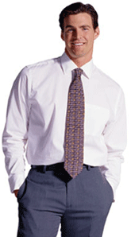
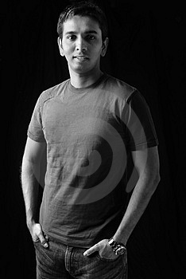
Who Would You Hire?

Slide 25
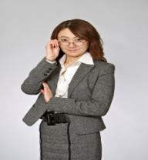
Tips Regarding Attire (Women)
A suit or dress is preferable
Skirts should meet at the top of the knee or longer
The amount of jewelry should be minimized
Make-up should be light

Slide 26
On the I- Day
Arrive before time
Wait patiently, utilize time in reading company newsletter, magazine etc.
Compose yourself

Slide 27
Body Gestures To Be Avoided
NERVOUSNESS
SUPERIORITY
DEFENSIVENESS
ANGER
DISGUST

Slide 28
During the Interview
Confident gait during entrance
Purposeful walk
Sit erect
Keep hands in your lap
Breathe normally, deep breath helps

Slide 29
Speak clearly with proper diction and without fillers
Be concise, logical and to the point
Avoid negative statements
BE YOURSELF….ALL THE BEST

